Slide 1
Angular 5
26-Apr-18 | Start
29-Apr-18 | 16
Appendix
Online

Slide 2
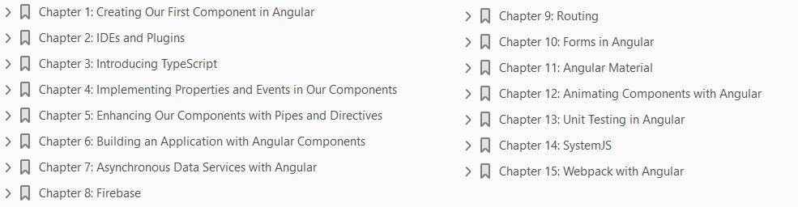
Angular 5
Ch | Date
1 | ddmmmyy
2
3
4
5
6
7
8
Learning Angular 5 12 2017 Packt

Slide 3
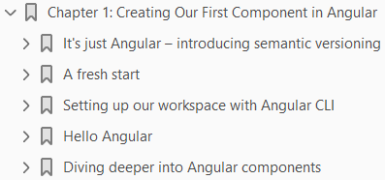
1
Creating Our First Component in Angular

Slide 4
Intro
When it comes to Angular development, there are some things that are good to know and some things that we need to know to embark on our great journey.
One of the things that is good to know is semantic versioning.
This is good to know because it is the way the Angular team has chosen to deal with changes.
This will hopefully make it easier to find the right solutions to future app development challenges when you go to https://angular.io/ or Stack Overflow and other sites to search for solutions.
Another important, but sometimes painful, topic is that of project setup.
It is a necessary evil that needs to be done in the beginning of a project, but getting this right early on can reduce a lot of friction as your application grows with you.
Therefore, a large part of this chapter is dedicated to demystifying and enabling you as a developer to save you from future frustrations and migraines.
We will also be able to create our first application at the end of this chapter and get a feel for the anatomy of an Angular application.
To sum up, here are the main themes that we will explore in this chapter.

Slide 5
Agenda
In this chapter, we will:
Learn about semantic versioning, why it matters, and Angular's take on it
Discover how we set up our project using Angular CLI
Create our first application and begin to understand the core concepts in Angular

Slide 6
It's just Angular – introducing semantic versioning
Using semantic versioning is about managing expectations.
It's about managing how the user of your application, or library, will react when a change happens to it.
Changes will happen for various reasons, either to fix something broken in the code or add/alter/remove a feature.
The way authors of frameworks or libraries use to convey what impact a certain change has is by incrementing the version number of the software.
A production-ready software usually has version 1.0 or 1.0.0 if you want to be more specific.
There are three different levels of change that can happen when updating your software.
Either you patch it and effectively correct something.
Or you make a minor change, which essentially means you add functionality.
Or lastly you make a major change, which might completely change how your software works.
Let's describe these changes in more detail in the following sections.

Slide 7
Patch change
A patch change means we increment the right most digit by one.
Changing the said software from 1.0.0 to 1.0.1 is a small change, usually a bug fix.
As a user of that software you don't really have to worry; if anything, you should be happy that something is suddenly working better.
The point is, you can safely start using 1.0.1.

Slide 8
Minor change
This means the software is increased from 1.0.0 to 1.1.0.
We are dealing with a more severe change as we increase the middle digit by one.
This number should be increased when functionality is added to the software and it should still be backwards compatible.
Also in this case it should be safe adapting the 1.1.0 version of the software.

Slide 9
Major change
At this stage, the version number increases from 1.0.0 to 2.0.0.
Now this is where you need to look out.
At this stage, things might have changed so much that constructs have been renamed or removed.
It might not be compatible to earlier versions.
I'm saying it might because a lot of software authors still ensure that there is a decent backwards compatibility, but the main point here is that there is no warranty, no contract, guaranteeing that it will still work.

Slide 10
What about Angular?
The first version of Angular was known by most people as Angular 1; it later became known as AngularJS.
It did not use semantic versioning. Most people actually still refer to it as Angular 1.
Then Angular came along and in 2016 it reached production readiness.
Angular decided to adopt semantic versioning and this caused a bit of confusion in the developer community, especially when it was announced that there would be an Angular 4 and 5, and so on.
Google, as well as the Google Developer Experts, started to explain to people that it wanted people to call the latest version of the framework Angular - just Angular.
You can always argue on the wisdom of that decision, but the fact remains, the new Angular is using semantic versioning.
This means Angular is the same platform as Angular 4, as well as Angular 11, and so on, if that ever comes out.
Adopting semantic versioning means that you as a user of Angular can rely on things working the same way until Google decides to increase the major version.
Even then it's up to you if you want to remain on the latest major version or want to upgrade your existing apps.

Slide 11
A Fresh Start
As mentioned before, Angular represents a full rewrite of the AngularJS framework, introducing a brand new application architecture completely built from scratch in TypeScript, a strict superset of JavaScript that adds optional static typing and support for interfaces and decorators.
In a nutshell, Angular applications are based on an architecture design that comprises of trees of web components interconnected by their own particular I/O interface.
Each component takes advantage under the covers of a completely revamped dependency injection mechanism.
To be fair, this is a simplistic description of what Angular really is.
However, the simplest project ever made in Angular is cut out by these definition traits.
We will focus on learning how to build interoperable components and manage dependency injection in the next chapters, before moving on to routing, web forms, and HTTP communication.
This also explains why we will not make explicit references to AngularJS throughout the book.
Obviously, it makes no sense to waste time and pages referring to something that will not provide any useful insights on the topic, besides the fact we assume that you might not know about Angular 1.x, so such knowledge does not have any value here.

Slide 12
Web components
Web components is a concept that encompasses four technologies designed to be used together to build feature elements with a higher level of visual expressivity and reusability, thereby leading to a more modular, consistent, and maintainable web.
These four technologies are as follows:
Templates: These are pieces of HTML that structure the content we aim to render
Custom elements: These templates not only contain traditional HTML elements, but also the custom wrapper items that provide further presentation elements or API functionalities
Shadow DOM: This provides a sandbox to encapsulate the CSS layout rules and JavaScript behaviors of each custom element
HTML imports: HTML is no longer constrained to host HTML elements, but to other HTML documents as well
In theory, an Angular component is indeed a custom element that contains a template to host the HTML structure of its layout, the latter being governed by a scoped CSS style sheet encapsulated within a shadow DOM container.

Slide 13
Web components |
Let's try to rephrase this in plain English. Think of the range input control type in HTML5. It is a handy way to give our users a convenient input control for entering a value ranging between two predefined boundaries.
If you have not used it before, insert the following piece of markup in a blank HTML template and load it in your browser:
You will see a nice input control featuring a horizontal slider in your browser.
Inspecting such control with the browser developer tools will unveil a concealed set of HTML tags that were not present at the time you edited your HTML template.
There you have an example of shadow DOM in action, with an actual HTML template governed by its own encapsulated CSS with advanced dragging functionality.
You will probably agree that it would be cool to do that yourself.

Slide 14
Web components ||
Well, the good news is that Angular gives you the toolset required for delivering this very same functionality, so we can build our own custom elements (input controls, personalized tags, and self-contained widgets) featuring the inner HTML markup of our choice and our very own style sheet that does not affect (nor is impacted) by the CSS of the page hosting our component.

Slide 15
Why TypeScript over other syntaxes?
Angular applications can be coded in a wide variety of languages and syntaxes:
ECMAScript 5
Dart
ECMAScript 6
TypeScript
ECMAScript 7
TypeScript is a typed superset of ECMAScript 6 (also known as ECMAScript 2015) that compiles to plain JavaScript and is widely supported by modern OSes.
It features a sound object-oriented design and supports annotations, decorators, and type checking.
The reason why we picked (and obviously recommend) TypeScript as the syntax of choice for instructing how to develop Angular applications in this book is based on the fact that Angular itself is written in this language.
Being proficient in TypeScript will give the developer an enormous advantage when it comes to understanding the guts of the framework.

Slide 16
Why TypeScript over other syntaxes? |
On the other hand, it is worth remarking that TypeScript's support for annotations and type introspection turns out to be paramount when it comes to managing dependency injection and type binding between components with a minimum code footprint, as we will see further down the line in this book.
Ultimately, you can carry out your Angular projects in plain ECMAScript 6 syntax if that is your preference.
Even the examples provided in this book can be easily ported to ES6 by removing type annotations and interfaces, or replacing the way dependency injection is handled in TypeScript with the most verbose ES6 way.
For the sake of brevity, we will only cover examples written in TypeScript and actually recommend its use because of its higher expressivity thanks to type annotations, and its neat way of approaching dependency injection based on type introspection out of such type annotations.

Slide 17
Setting up our workspace with Angular CLI
There are different ways to get started, either using
the Angular quickstart repository on the https://angular.io/ site
installing the scaffolding tool Angular CLI
you could use Webpack to set up your project.
It is worth pointing out that the standard way of creating a new Angular project is through using Angular CLI and scaffold your project.
Systemjs, used by the quickstart repository, is something that used to be the default way of building Angular projects.
It is now rapidly diminishing, but it is still a valid way of setting up an Angular project.
The interested reader is therefore recommended to check the Appendix A, SystemJS for more information on it.
Setting up a frontend project today is more cumbersome than ever.
We used to just include the necessary script with our JavaScript code and a link tag for our CSS and img tag for our assets and so on. Life used to be simple.
Then frontend development became more ambitious and we started splitting up our code in modules, we started using preprocessors for both our code and CSS.

Slide 18
Setting up our workspace with Angular CLI |
Setting up a project with leading frameworks such as React or Angular can be quite difficult.
You need to know what libraries to import and ensure that files are processed in the correct order, which leads us into the topic of scaffolding tools.
For AngularJS, it was quite popular to use Yeoman to scaffold up a new application quickly and get a lot of nice things preconfigured.
React has a scaffolder tool called create-react-app, which you probably have saved and it saves countless hours for React developers.
Scaffolder tools becomes almost a necessity as complexity grows, but also where every hour counts towards producing business value rather than fighting configuration problems.
The main motivation behind creating the Angular CLI tool was to help developers focus on app building and not so much on configuration.
Essentially, with a simple command, you should be able to scaffold an application, add a new construct to it, run tests, or create a production grade bundle.
Angular CLI supports all that.

Slide 19
Prerequisites
What you need to get started is to have Git and Node.js installed.
Node.js will also install something called NPM, a node package manager that you will use later to install files you need for your project.
After this is done, you are ready to set up your Angular application.
You can find installation files to Node.js at https://nodejs.org.
The easiest way to have it installed is to go to the site: https://nodejs.org/en/download/
Installing Node.js will also install something called NPM, Node Package Manager, which you will need to install dependencies and more.
The Angular CLI requires Node 6.9.0 and NPM 3 or higher.
Currently on the site, you can choose between an LTS version and the current version.
The LTS version should be enough.

Slide 20
Installation
Installing the Angular CLI is as easy as running the following command in your Terminal:
On some systems, you may need to have elevated permissions to do so; in that case, run your Terminal window as an administrator and on Linux/macOS instead run the command like this:

Slide 21


First app
Once the Angular CLI is in place the time has come to create your first project.
To do so place yourself in a directory of your choice and type the following:
Type the following:
This will create a directory called TodoApp.
After you have run the preceding command, there are two things you need to do to see your app in a browser:
Navigate to the just created directory
Serve up the application
This will be accomplished by the following commands:

Slide 22
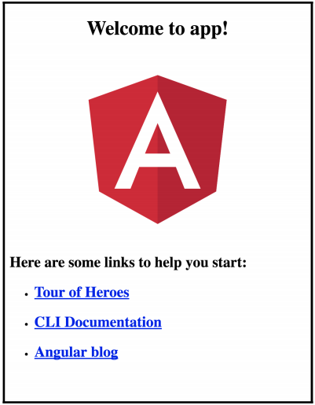
First app |
At this point, open up your browser on http://localhost:4200 and you should see the following:

Slide 23
Testing
The Angular CLI doesn't just come with code that makes your app work.
It also comes with code that sets up testing and includes a test. Running the said test is as easy as typing the following in the Terminal:
You should see the content as shown in Figure 1A.
How come this works? Let's have a look at the package.json file that was just created and the scripts tag.
Everything specified here can be run using the following syntax:
In some cases, it is not necessary to type run and it will be enough to just type:
This is the case with the start and test commands.

Slide 24
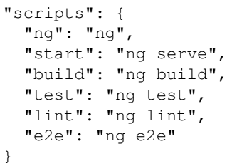
Testing |
The following listing makes it clear that it is possible to run more commands than start and test that we just learned about:
So far we have learned how to install the Angular CLI. Using the Angular CLI we have learned to:
Scaffold a new project.
Serve up the project and see it displayed in a browser.
Run tests.
That is quite an accomplishment.
We will revisit the Angular CLI in a later chapter as it is a very competent tool, capable of a lot more.

Slide 25
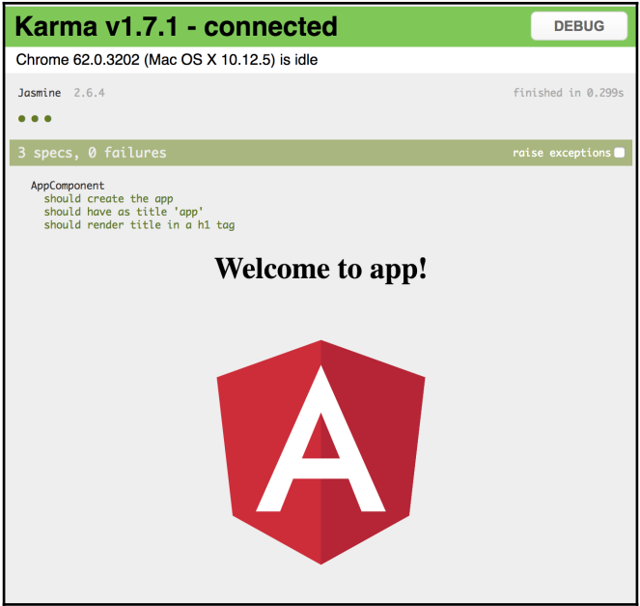
Figure 1A

Slide 26
Hello Angular
We are about to take the first trembling steps into building our first component.
The Angular CLI has already scaffolded our project and thereby carried out a lot of heavy lifting.
All we need to do is to create new file and starting filling it with content.
The million dollar question is what to type? So let's venture into building our first component.
There are three steps you need to take in creating a component. Those are:
Import the component decorator construct.
Decorate a class with a component decorator.
Add a component to its module ( this might be in two different places).

Slide 27

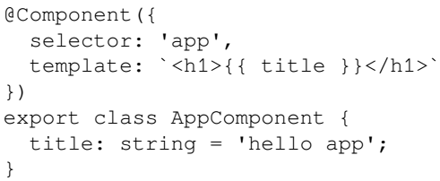
Creating the component
First off, let's import the component decorator:
Then create the class for your component:
Then decorate your class using the Component decorator:
We give the Component decorator, which is function, an object literal as an input parameter.
The object literal consists at this point of the selector and template keys, so let's explain what those are.

Slide 28

Selector
A selector is what it should be referred to if used in a template somewhere else.
As we call it app, we would refer to it as:

Slide 29


Template/templateUrl
The template or templateUrl is your view.
Here you can write HTML markup.
Using the template keyword, in our object literal, means we get to define the HTML markup in the same file as the component class.
Were we to use templateUrl, we would then place our HTML markup in a separate file.
The preceding example also lists the following double curly braces, in the markup:
This will be treated as an interpolation and the expression will be replaced with the value of AppComponent's title field. The component, when rendered, will therefore look like this:

Slide 30
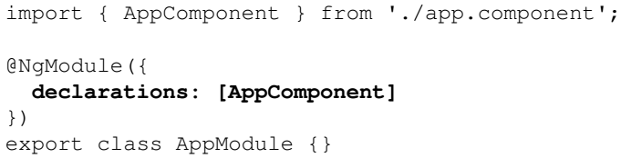
Telling the module
Now we need to introduce a completely new concept, an Angular module.
All types of constructs that you create in Angular should be registered with a module.
An Angular module serves as a facade to the outside world and it is nothing more than a class that is decorated by the decorate @NgModule.
Just like the @Component decorator, the @NgModule decorator takes an object literal as an input parameter.
To register our component with our Angular module, we need to give the object literal the property declarations.
The declarations property is of a type array and by adding our component to that array we are registering it with the Angular module.
The following code shows the creation of an Angular module and the component being registered with it by being added to declarations keyword array:

Slide 31
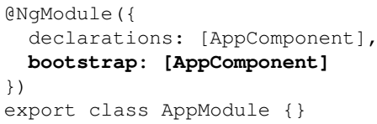
Telling the module |
At this point, our Angular module knows about the component.
We need to add one more property to our module, bootstrap.
The bootstrap keyword states that whatever is placed in here serves as the entry component for the entire application.
Because we only have one component, so far, it makes sense to register our component with this bootstrap keyword:
It's definitely possible to have more than one entry component, but the usual scenario is that there is only one.
For any future components, however, we will only need to add them to the declarations property, to ensure the module knows about them.

Slide 32
Telling the module ||
So far we have created a component and an Angular module and registered the component with said the module.
We don't really have a working application yet, as there is one more step we need to take.
We need to set up the bootstrapping.

Slide 33
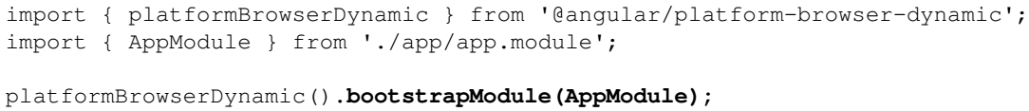
Setting Up a bootstrap file
The main.ts file is your bootstrap file and it should have the following content:
What we do in the preceding code snippet is to provide the recently created module as an input parameter to the method call bootstrapModule( ).
This will effectively make the said module, the entry module of the application.
This is all we need to create a working application.
Let's summarize the steps we took to accomplish that:
Create a component.
Create a module and register our created component in its declaration property.
Also register our component in the modules bootstrap property to make it serve as an application entry point.
Future components we create just need to be added to the declarations property.

Slide 34
Setting Up a bootstrap file |
Bootstrap our created module by using the said module as an input parameter to the bootstrapModule( ) method.
You as a reader have had to swallow a lot of information at this point and take our word for it.
Don't worry, you will get a chance to get more acquainted with components in this chapter as well as Angular modules in upcoming chapters.
For now, the focus was just to get you up and running by giving you a powerful tool in the form of the Angular CLI and show you how few steps are actually needed to have an app rendered to the screen.

Slide 35
Diving deeper into Angular components
We have come a long way now, from tapping on TypeScript for the first time to learning how to code the basic scripting schema of an Angular component.
However, before jumping into more abstract topics, let's try to build another component so we really get the hang of how creating it really works.

Slide 36
Component methods and data updates
Create a new timer.component.ts file in the same folder and populate it with the basic implementation of a very simple component Listing 1-1.
Don't worry about the added complexity, as we will review each and every change made after the code block.
At this point, we have created a whole new component by creating the TimerComponent class and decorated it with @Component, just as we learned how to do in a previous section.
We learned in the previous section that there is more to be done, namely to tell an Angular module that this new component exists.
The Angular module is already created so you just need to add our fresh new component to its declarations property: Listing 1-2.
As long as we only had the AppComponent we didn't really see the point of having an Angular module.
With two components registered with our module, this changes.
When a component is registered with an Angular module it becomes available to other constructs in the module.
It becomes available to their template/templateUrl. This means that we can have TimerComponent rendered inside of our AppComponent.

Slide 37
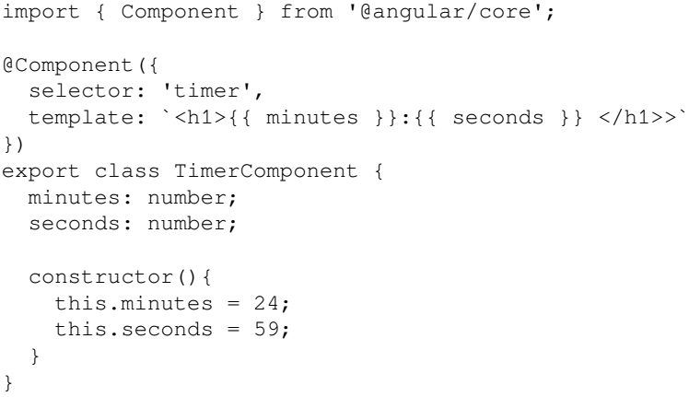
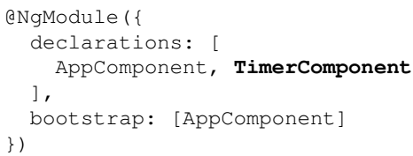
Listing 1-1 || 1-2

Slide 38
Updating AppComponent file
Let's therefore go back to our AppComponent file and update its template to show just that: Listing 1-3.
In the listing, we highlight in bold how we add the TimerComponent to the AppComponents template.
Or rather we refer to the TimerComponent by its selector property name, which is timer.
Let's show the TimerComponent again, in it's entirety, and highlight the selector property because this is a really important thing to understand; that is, how to place a component in another component: Listing 1-1.
We want to do more than just display a handful of numbers, right? We actually want them to represent a time countdown, and we can achieve that by introducing these changes.
Let's first introduce a function we can iterate on in order to update the countdown.
Add the function shown in Listing 1-4 after the constructor function.

Slide 39
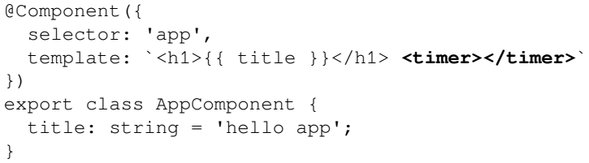
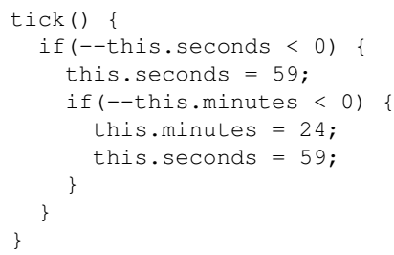
Listing 1-3 || 1-4

Slide 40
NOTE
Selectors in Angular are case sensitive.
As we will see later in this book, components are a subset of directives that can support a wide range of selectors.
When creating components, we are supposed to set a custom tag name in the selector property by enforcing a dash-casing naming convention.
When rendering that tag in our view, we should always close the tag as a non-void element.
So <custom-element></custom-element> is correct, while <custom-element /> will trigger an exception.
Last but not least, certain common camel case names might conflict with the Angular implementation, so avoid them.

Slide 41
Going from static to actual data
As you can see here, functions in TypeScript need to be annotated with the type of the value they return, or just void if none.
Our function assesses the current value of both minutes and seconds, and then either decreases their value or just resets it to the initial value.
Then this function is called every second by triggering a time interval from the class constructor: Listing 1-5.
Here, we spot for the first time in our code an arrow function (also known as a lambda function, fat arrow, and so on), a new syntax for functions brought by ECMAScript 6, which we will cover in more detail in Chapter 3, Introducing TypeScript.
The tick function is also marked as private, so it cannot be inspected or executed outside a PomodoroTimerComponent object instance.
So far so good! We have a working Pomodoro timer that countdowns from 25 minutes to 0, and then starts all over again.
The problem is that we are replicating code here and there. So, let's refactor everything a little bit to prevent code duplication: Listing 1-6.
We have wrapped the initialization (and reset) of minutes and seconds inside our function resetPomodoro, which is called upon instantiating the component or reaching the end of the countdown.

Slide 42
Going from static to actual data |
Wait a moment though! According to the Pomodoro technique, Pomodoro practitioners are allowed to rest in between Pomodoros or even pause them should an unexpected circumstance get in the way.
We need to provide some sort of interactivity so the user can
Start
pause, and
resume the current Pomodoro timer

Slide 43
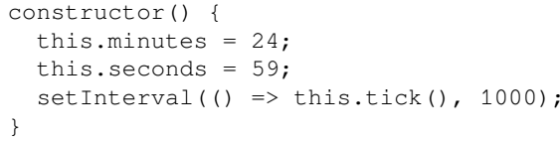
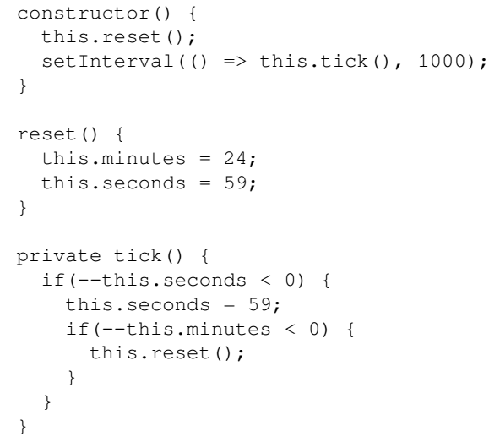
Listing 1-5 || 1-6

Slide 45
Adding interactivity to the component

Slide 46
Improving the data output

Slide 47

2
IDEs and Plugins

Slide 48
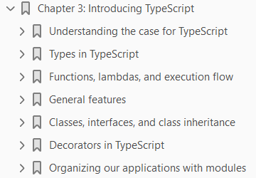
3
Introducing TypeScript

Slide 49

4
Implementing Properties and Events in Our Components

Slide 50
Intro
So far, we have had the opportunity to take a bird's eye overview of
what components are in the new Angular ecosystem
what their role is
how they behave, and
what tools are required to start building our own components to represent
widgets and
pieces of functionality
In addition, TypeScript turns out to be the perfect companion for this endeavor, so we seem to have everything that we need to further explore the possibilities that Angular brings to the game with regards to creating interactive components that expose properties and emit events.
In this chapter, we will:
Discover all the syntactic possibilities at our disposal to bind content in our templates
Create public APIs for our components so that we can benefit from their properties and event handlers
See how to implement data binding in Angular
Reduce the complexity of CSS management with view encapsulation

Slide 51
A better template syntax
In Chapter 1, Creating Our Very First Component in Angular, we saw how to embed HTML templates in our components, but we didn't even scratch the surface of template development for Angular.
As we will see later in this book, template implementation is tightly coupled with the principles of Shadow DOM design and it brings out a lot of syntactic sugar to ease the task of binding properties and events in our views in a declarative fashion.
In a nutshell, Angular components may expose a public API that allows them to communicate with other components or containers.
This API may encompass input properties, which we use to feed the component with data.
It also may expose output properties we can bind event listeners to, thereby getting prompt information about changes in the state of the component.
Let's take a look at the way Angular solves the problem of injecting data in and out of our components through quick and easy examples.
Please focus on the philosophy behind these properties.
We will have a chance to see them in action later.

Slide 52
Data bindings with input properties

Slide 53
Some extra syntactic sugar: binding expressions

Slide 54
Event binding with output properties

Slide 55
Input and output properties in action

Slide 56
Emitting data through custom events

Slide 57
Local references in templates

Slide 58
Alternative syntax for input & output properties

Slide 59
Configuring our template: component class

Slide 60
9
Routing

Slide 61
Intro
In the previous chapters, we did a great job separating concerns in our applications and adding different layers of abstraction to increase the maintainability of the app.
However, we have neglected the visual side of things, as well as the user experience part.
At this moment, our UI is bloated with components and stuff scattered across a single screen, and we need to provide a better navigational experience and a logical way to change the application's state intuitively.
This is the moment where routing acquires special relevance and gives us the opportunity to build a navigational narrative for our applications, allowing us to split the different areas of interest into different pages that are interconnected by a grid of links and URLs.
However, our application is only a set of components, so how do we deploy a navigation scheme between them?
The Angular router was built with componentization in mind.
We will see how can we create our custom links and make components react to them in the following pages.

Slide 62
Agenda
In this chapter, we will:
Discover how to define routes to switch components on and off, and redirect them to other routes
Trigger routes and load components in our views, depending on the requested route
Handle and pass different types of parameters
Dive into more advanced routing
Look at different ways of securing our routes
Uncover how to improve the response time by looking at different async strategies

Slide 63
Adding support for the Angular router
Having routing in your application means you want to navigate between different topics in your navigation.
You usually use a top menu or left menu and press on links to get where you want.
This causes the URL in the browser to change.
In a Single-Page Application (SPA), this doesn't cause a page reload.
To get set up with the Angular router is quite easy, but there are some things we need in place for it to be considered set up:
Specify a base element in index.html
Import the RouterModule and tell the root module about it
Set up a routing dictionary
Decide on where to place the viewport of your application, that is, decide where in the page your content should be placed
Interact with a routing service if you want to investigate things such as routing or query parameters, or if you need to programmatically route the user to another page in your application

Slide 64

Specifying the base element
We need to inform Angular about the base path we want to use, so it can properly build and recognize the URLs as the user browses the website, as we will see in the next section.
Our first task will be to insert a base href statement within our <HEAD> element.
Append the following line of code at the end of your code statement inside the <head> tag:
The base tag informs the browser about the path it should follow while attempting to load external resources, such as media or CSS files, once it goes deeper into the URL hierarchy.

Slide 65

Importing and setting up the router module
Now, we can start playing around with all the goodies existing in the router library.
First things first, we need to import the RouterModule, we do this in the root module of our application.
So, we open a file called app.module.ts and insert the following line at the top of the file:
Once we have done so, it's time to add the RouterModule as a dependency of the AppModule class.
RouterModule is a little bit of a different module, though; it needs to be initialized at the same time as it is added as a dependant module. It looks like the following:
We can see here that it points to variable routes that we have yet to define.

Slide 66
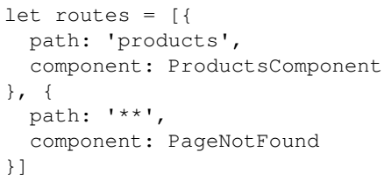
Defining the routes
The routes is a list of route entries that specifies what routes exist in the application and what components should respond to a specific route.
It can look like this:
Every item in the route list is an object with a number of properties.
The two most important properties are path and component.
The path property is the routing path, note that you should specify the path value without a leading /.
So, setting it to products, as with the preceding code, means that we define what would happen if the user navigates to /products.
The component property points to the component that should respond to this route.
The pointed-out components, template and data is what the user will see when navigating to the route.

Slide 67
Defining the routes |
The first specified route defines the path /products, and the last route item specifies **, which means it matches any path.
Order matters.
Had we defined the route item ** first, then products would never have been hit.
The reason ** was defined last was that we wanted a route that would take care of the case when a user enters an unknown route.
Rather than showing the user a blank page, we can now show them a nice page defined by the PageNotFound components template.
There are a ton more properties you can define on a route item, and also more complex routes you can set up.
This will suffice for now, so we gain a basic understanding of routing setup.

Slide 68
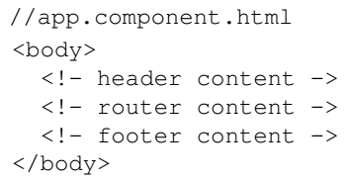
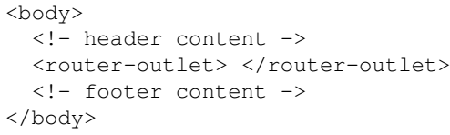
Defining a viewport
Once we have come this far, it's time to define a viewport where the routed content should be rendered.
Normally, we would build an application where part of the content is static and part of it can be switched out, like so:
At this point, we involve the router-outlet element. It is an element that tells the router that this is where you should render the content. Update your app.component.html to look like this:

Slide 69
Defining a viewport |
Now we have the router module imported and initialized.
We also have a router list defined for two routes, and we have defined where the routed content should be rendered.
This is all we need for a minimal setup of the router.
In the next section, we will look at a more realistic example and further expand our knowledge of the routing module and what it can help us with.

Slide 70
Building practical Ex: Setting up router service
Let's describe the problem domain.
Through the course of this book, we have been dealing with Tasks within the context of Pomodoro sessions.
So far we have been creating all the components and other constructs that we needed in one big visual pile.
It's a visual pile in the sense that everything has been visible in one page.
A more natural approach to this is to imagine that we have dedicated views that we navigate between.
Here are the options from a user standpoint:
The user reaches our app and checks the current listing of the pending tasks.
The user can schedule the tasks to be done in order to get the required time estimation for the next Pomodoro session.
If desired, the user can jump onto another page and see a create task form (we will create the form, but will not implement its editing features until the next chapter).
The user can choose any task at any time and begin the Pomodoro session required to accomplish it.
The user can move back and forth across the pages they have already visited.

Slide 71
Building practical Ex: Setting up router service|
Let's take the preceding user interactions and translate what this means in terms of different views that we should support:
There needs to be a page listing all the tasks
There should be a page with a create task form
Lastly, there should be a way to navigate back and forth between the pages

Slide 72
Building a new component for demo purposes
So far, we have built two well-differentiated components we can leverage to deliver a multipage navigation.
But in order to provide a better user experience, we might need a third one.
We will now introduce the form component we will be exploring more thoroughly in Chapter 10, Forms in Angular, as a way to have more navigation options in our example.
We will create a component in our tasks feature folder, anticipating the form we will use in the next chapter to publish new tasks.
Create the following files in the locations pointed out for each one: Code 9-1.
This is the most basic definition of a component.
We need to expose this new component from our feature module.
Finally, we need to enter the route item for this component in a route list and configure the routes.
Add the code snippet in the app/tasks/task.module.ts file: Code 9-2.
Now the time has come to configure the routes.
We do this in two steps:
Creating the routes.ts, a module that contains our routes
Setting up the routes in the root module

Slide 73
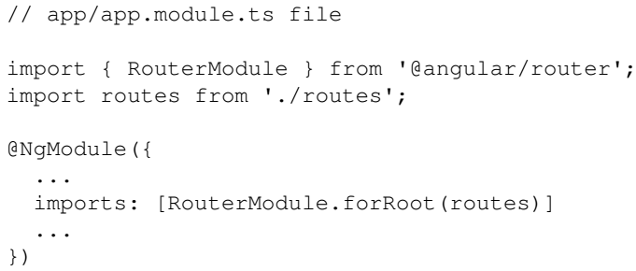
Building a new component for demo purposes |
The first order of business is defining the routes: Code 9-3.
The second order of business is initializing the routes.
We do this in the root module.
To initialize the routes, we need to call RouteModule and its static method, forRoot, and provide it with the routes list as an argument:

Slide 74
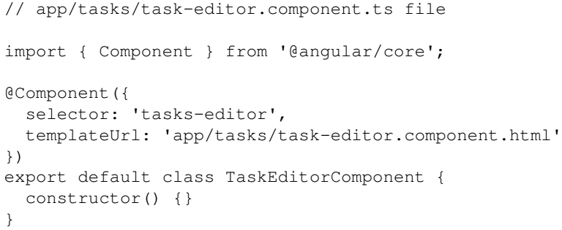
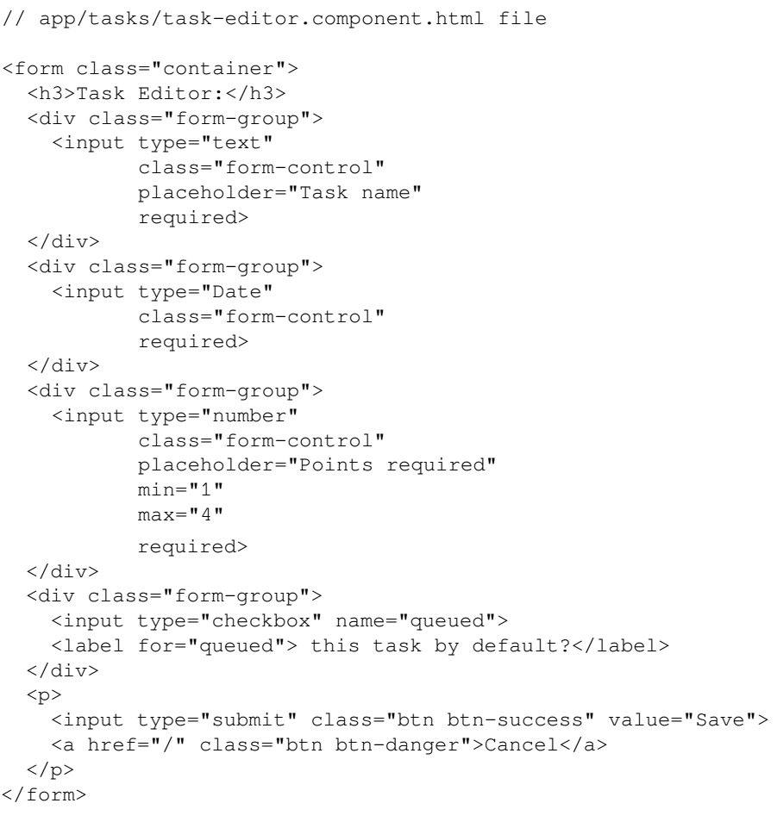
Code 9-1

Slide 75
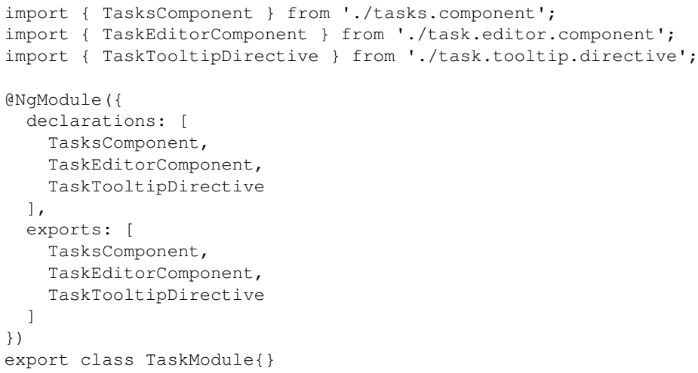
Code 9-2

Slide 76
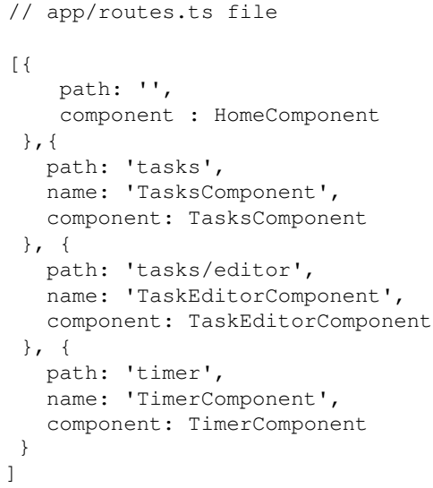
Code 9-3

Slide 77
Cleaning up the routes
At this point, we have set up the routes so they work the way they should.
However, this approach doesn't scale so well.
As your application grows, more and more routes will be added to the routes.ts file.
Just like we moved the components and other constructs into their respective feature directory, so should we move the routes to where they belong.
Our routing list so far consists of one route item belonging to the timer feature, two items to the task feature, and one route that points to the default route /.
Our cleanup work will consist of:
Creating one dedicated routes.ts file per feature directory
Calling RouteModule.forChild in each feature module that has routes
Removing routes from any root module that isn't strictly application-wide, for example ** = route not found
This means that the application structure now looks something like: Figure 9-1.
After the creation of a few more files, we are ready to initialize our feature routes.

Slide 78
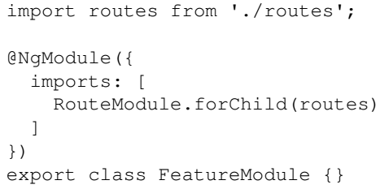
Cleaning up the routes |
Essentially, the initialization is the same for both /timer/routes.ts as /task/routes.ts.
For that reason, let's look at one of the routes.ts files and the intended change:
The point here is that moving routes from app/routes.ts to <feature>/routes.ts means we set up the routes in their respective module file instead, namely <feature>/<feature>.module.ts.
Also, we call RouteModule.forChild, and not RouteModule.forRoot, when setting up feature routes.

Slide 79
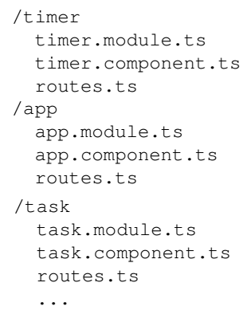
Figure 9-1

Slide 80
The router directives

Slide 81
Triggering routes imperatively

Slide 82
Handling parameters

